Slide 1
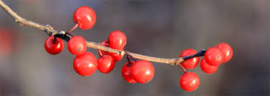
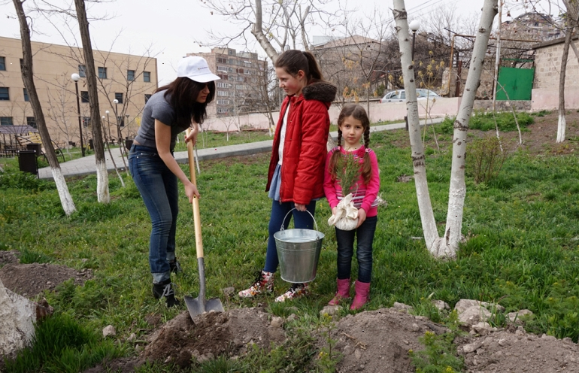

How to Plant a Tree Anahit Gharibyan Community Outreach Manager

Slide 2
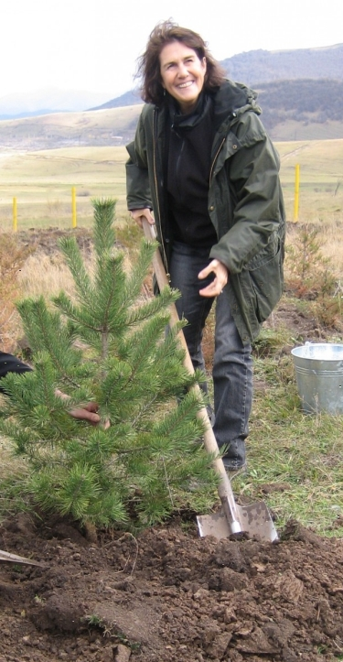
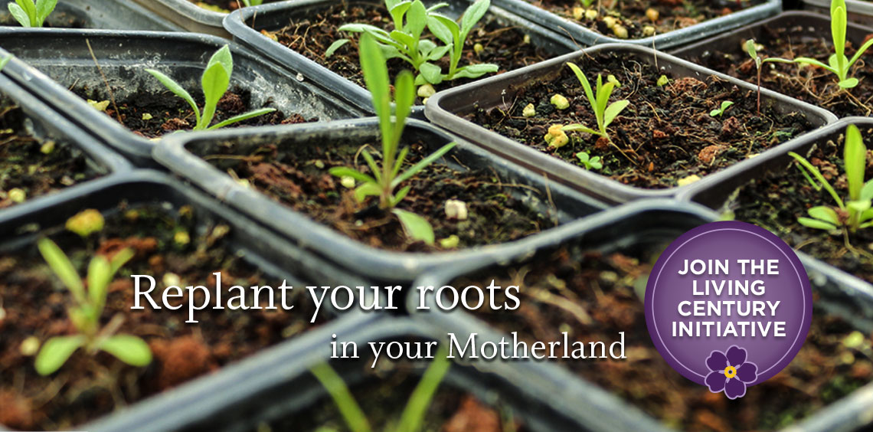

Who we are? ATP Founder, Carolyn Mugar

Slide 3
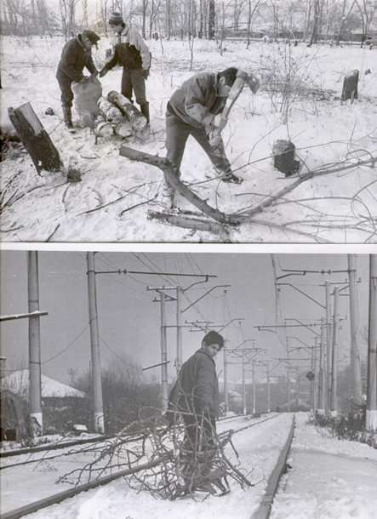
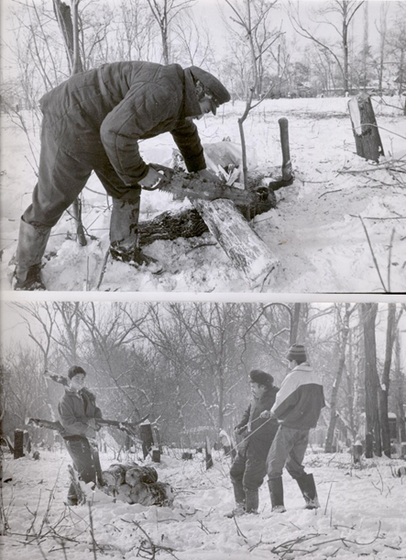
Economic and Energetic Crisis in Armenia of the 1990’s

Slide 4
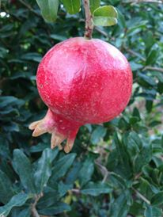
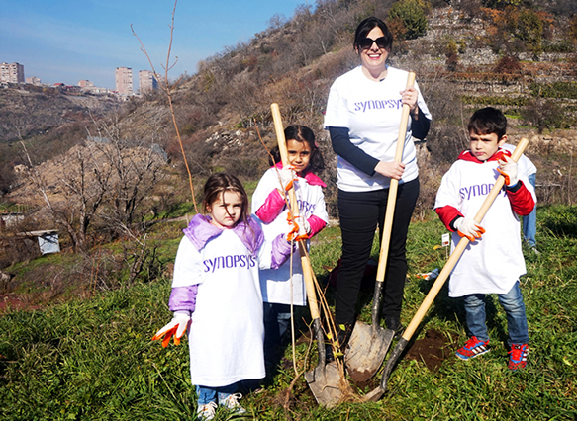
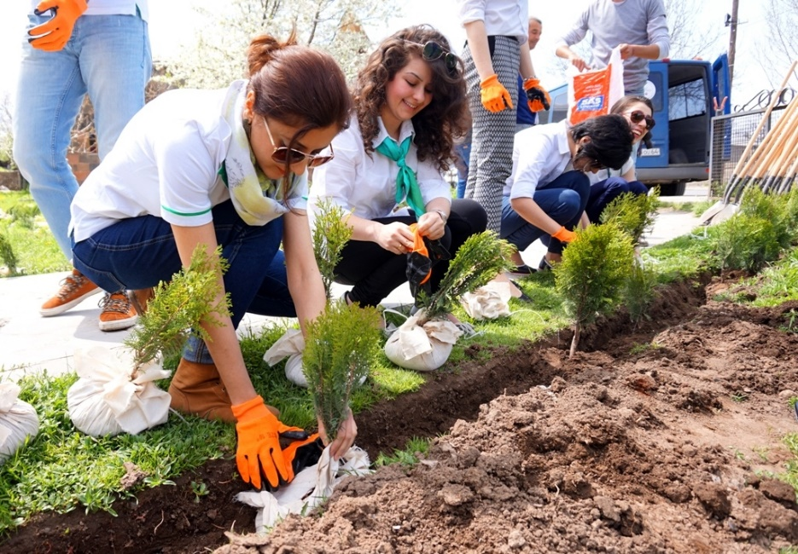
Community Tree Planting

Slide 5
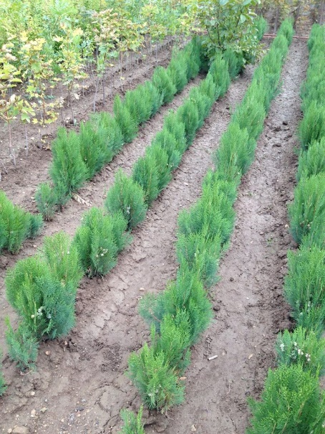
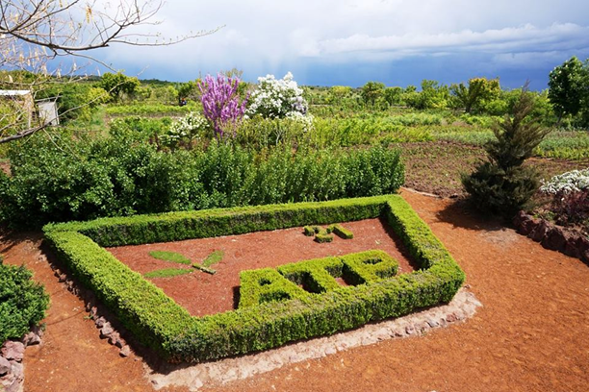
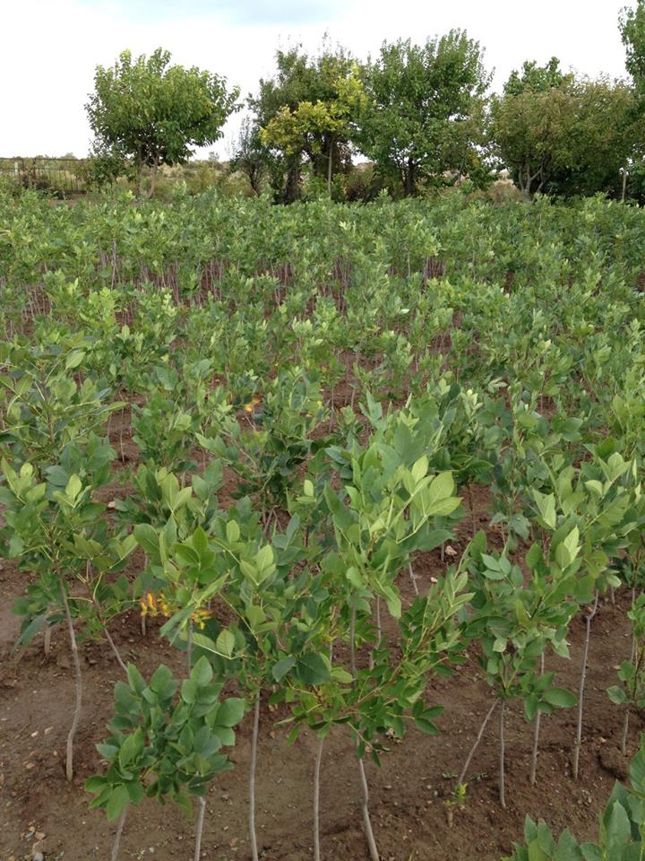
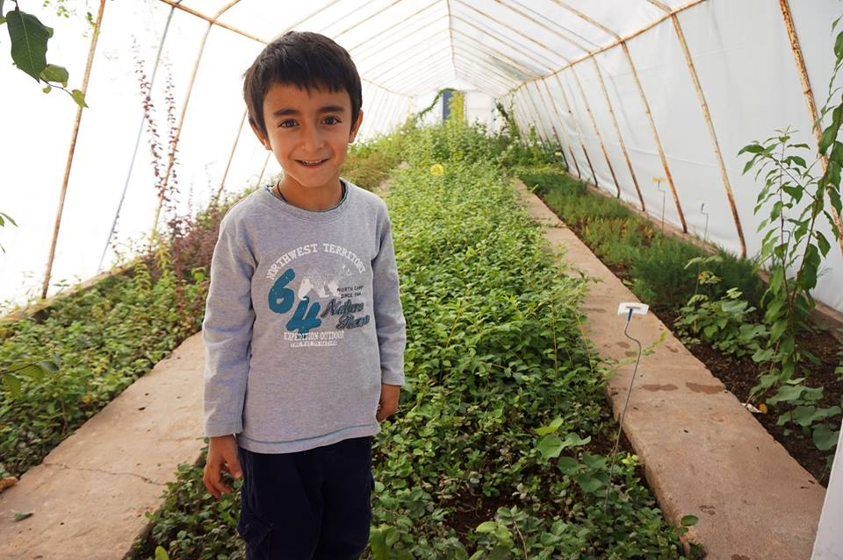
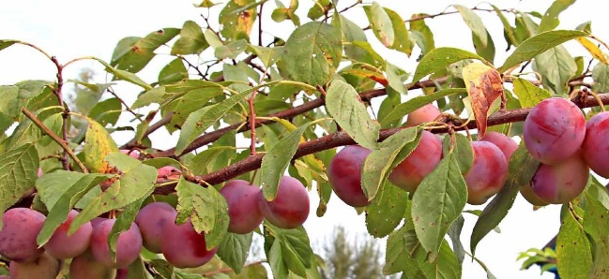

Nurseries

Slide 6
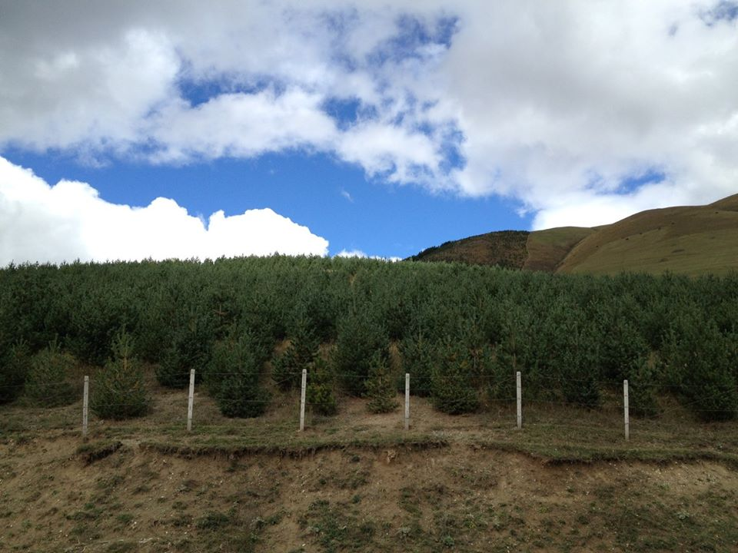
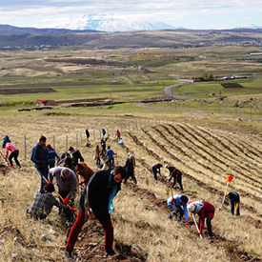
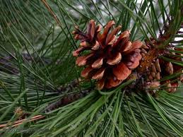
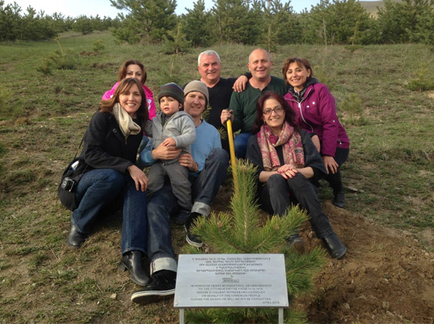

Forestry

Slide 7
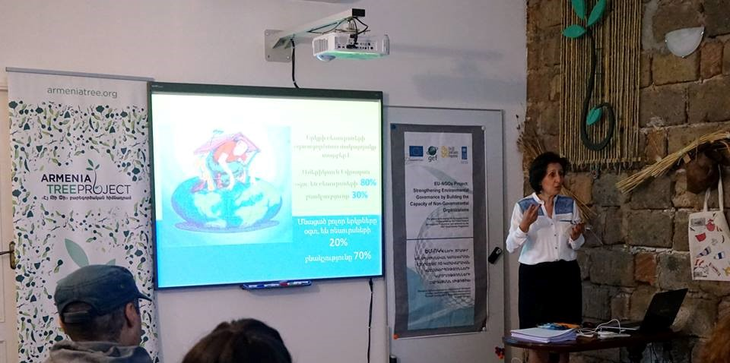
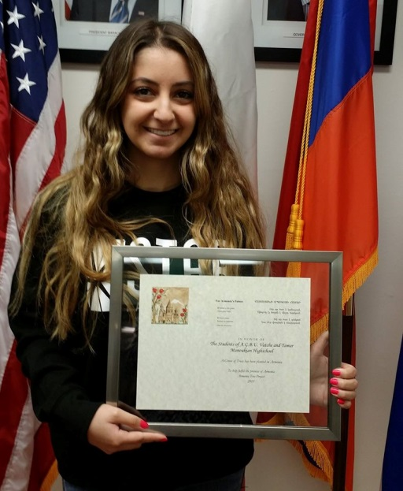
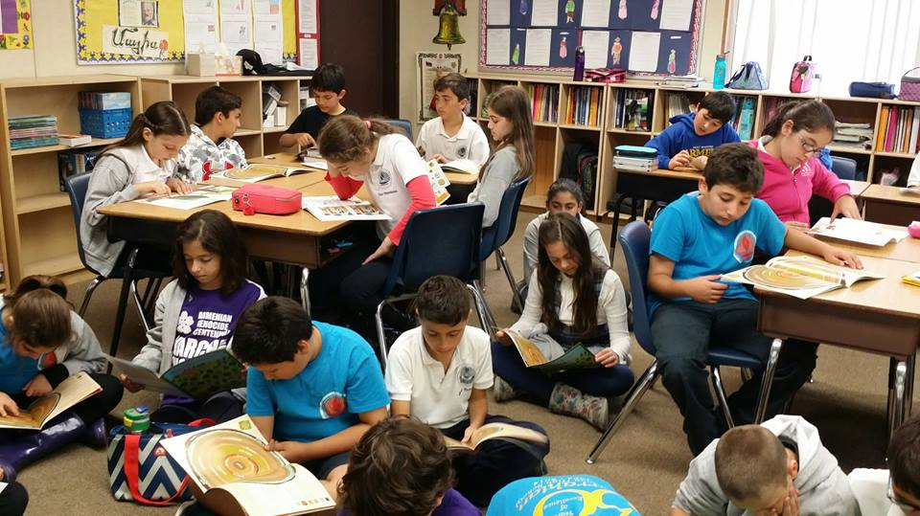
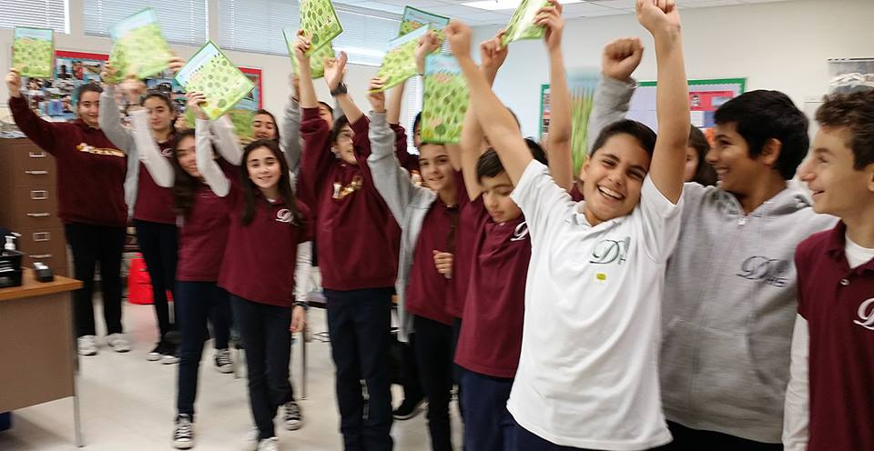
Environmental Education

Slide 8

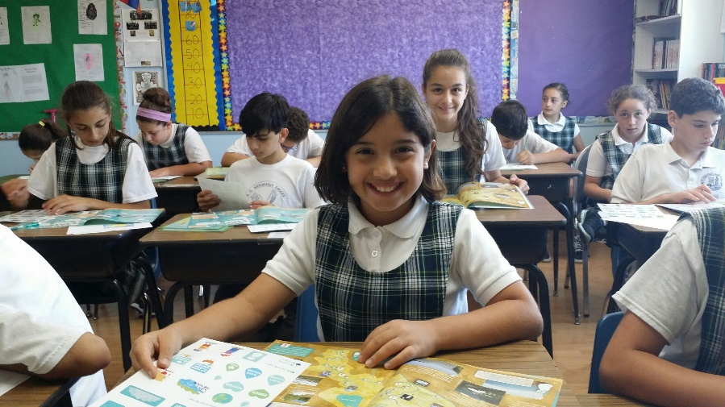
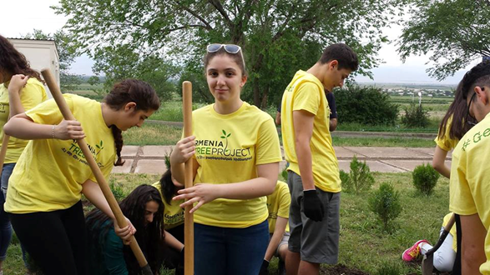
To develop the capacity of Armenian schools to be significant drivers in the quest for environmental and cultural security.
We envision an Armenia where its citizens take a powerful role in determining the future development of a clean and healthy environment - an environment that encourages respect for the past with eyes on the future.

Slide 9
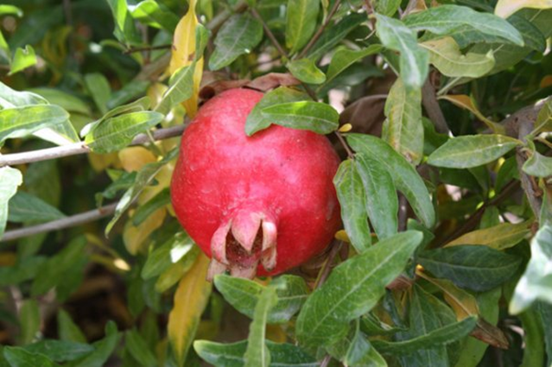
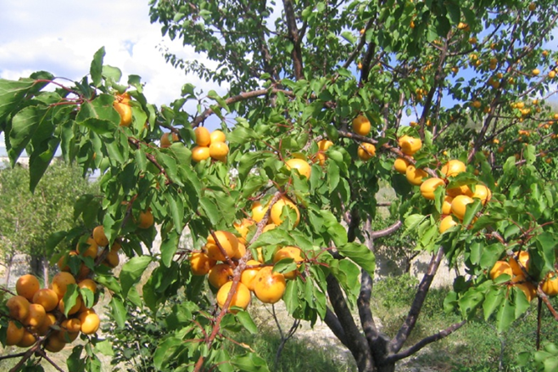
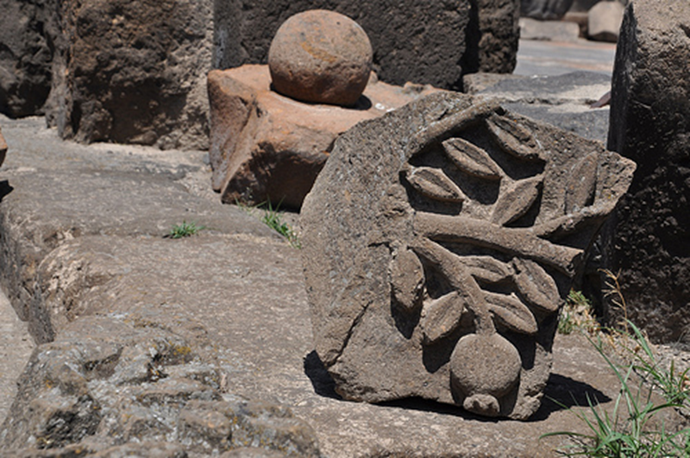
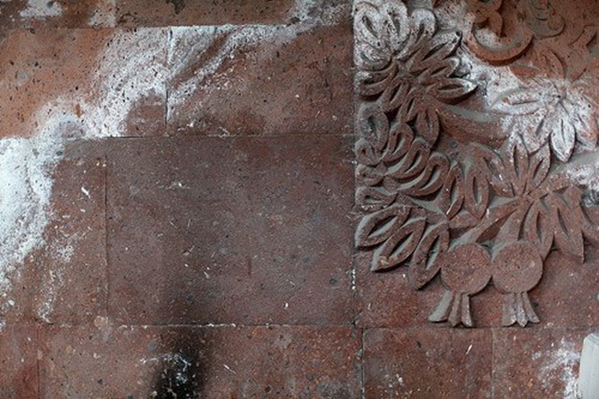
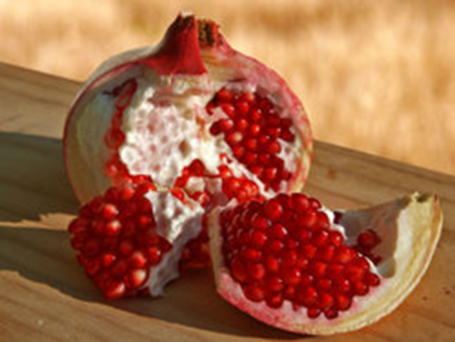
Symbols of Armenia

Slide 10
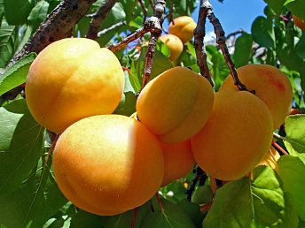
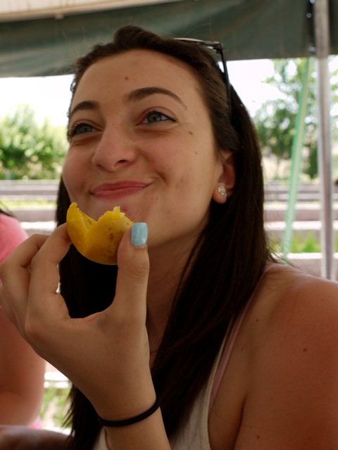
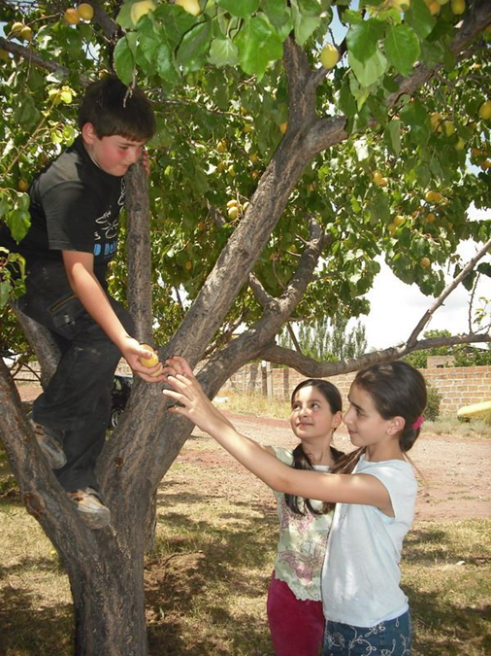
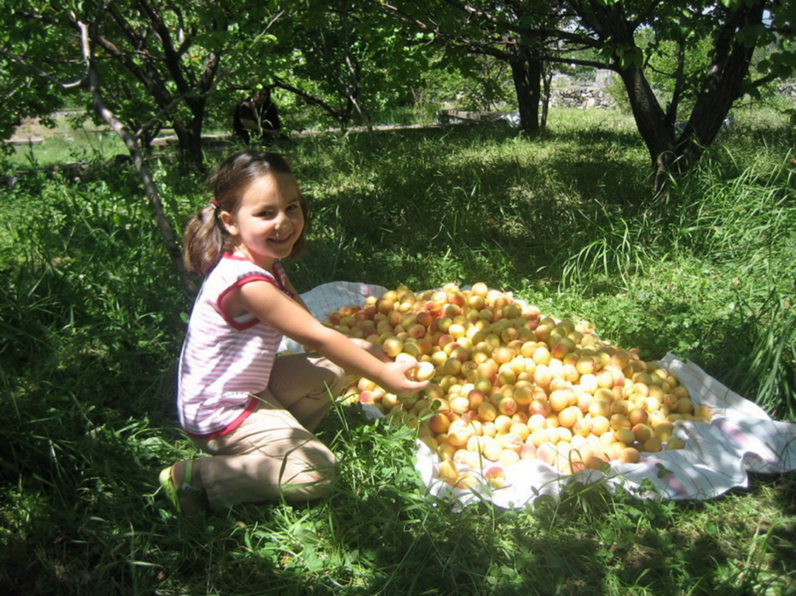
BENEFITS Trees provide food

Slide 11


Trees clean the air & provide oxygen

Slide 12
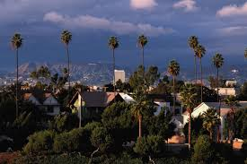
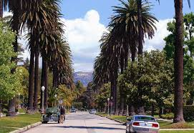
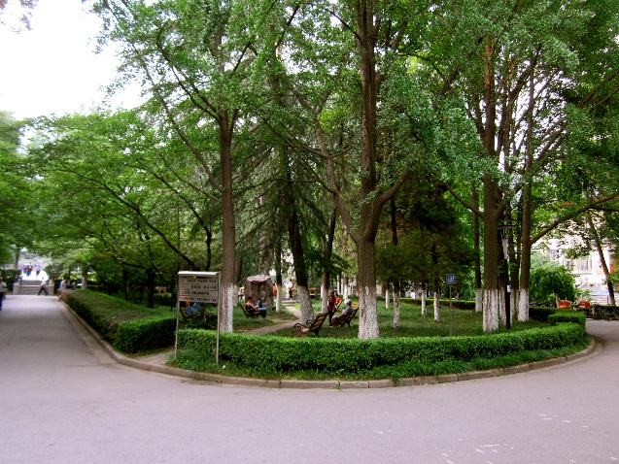
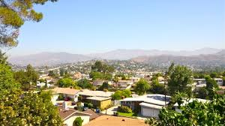
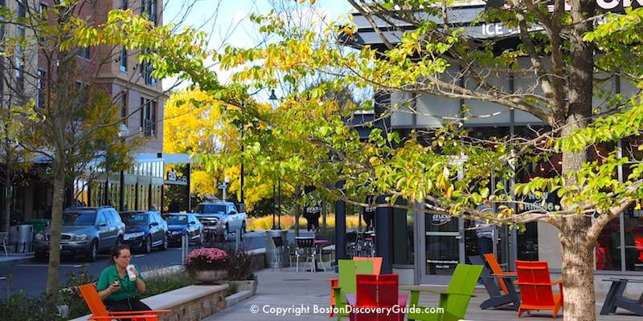
Trees cool the city & streets by providing shade

Slide 13
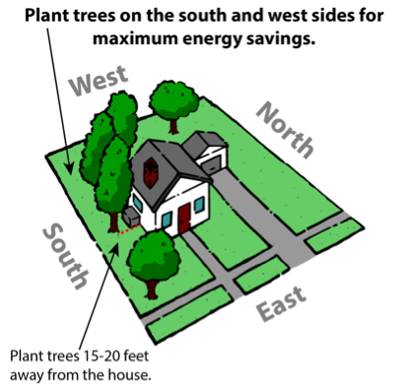
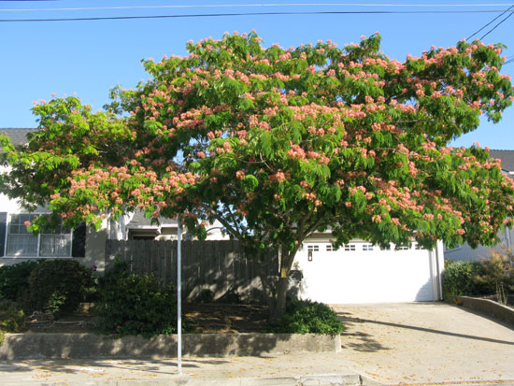
Trees conserve energy

Slide 14
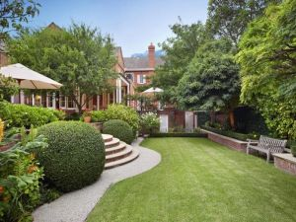
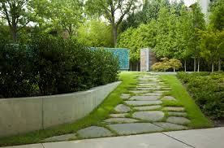
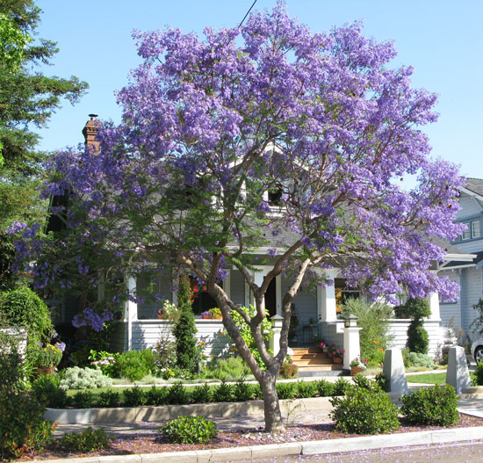
Trees increase property values

Slide 15
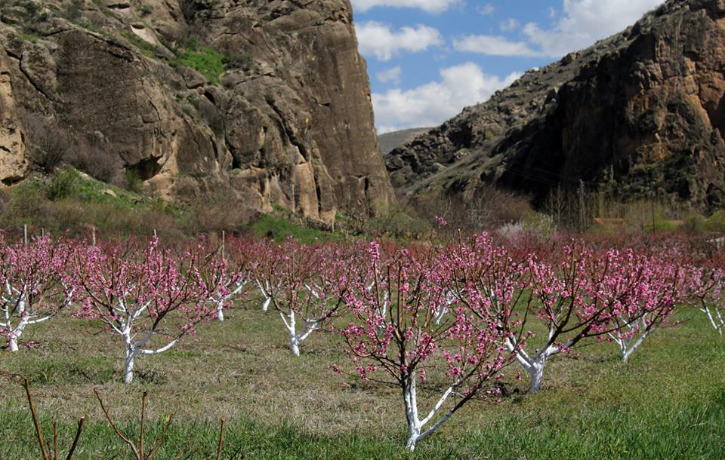
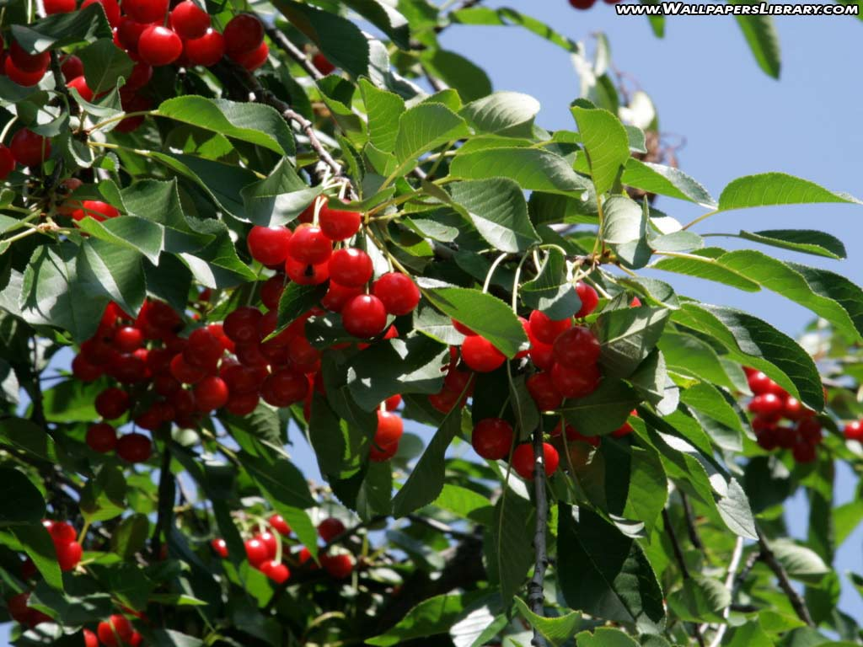
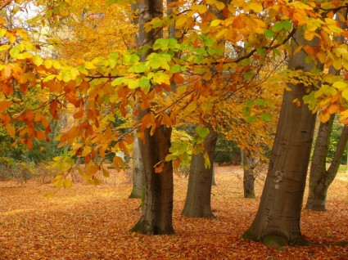
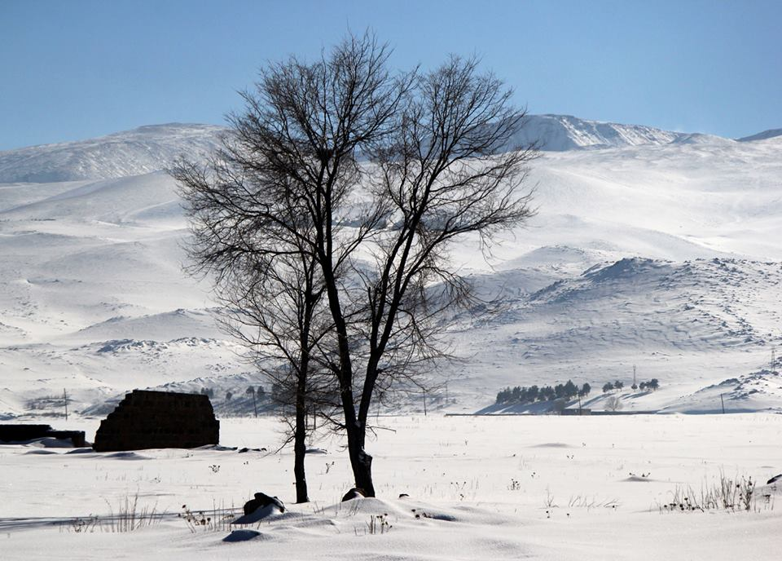

Trees mark the season

Slide 16
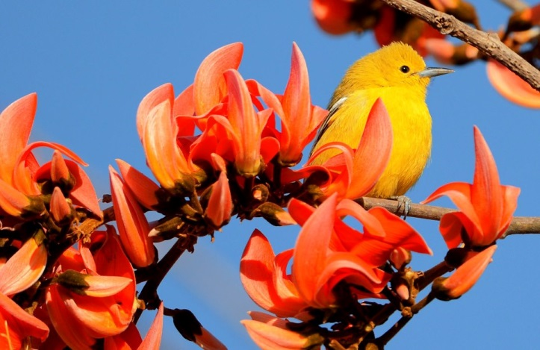
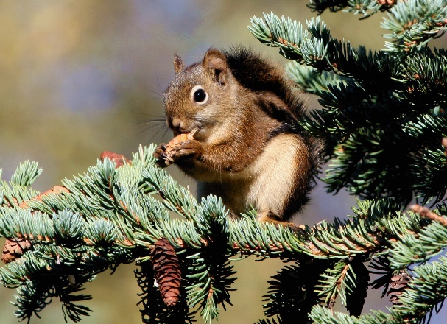
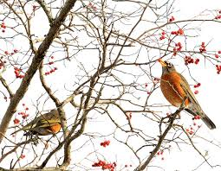

Trees provide a canopy and habitat for wildlife

Slide 17






Trees provide many resources
such as wood and paper

Slide 18




Trees have medicinal value & can shield children from UV rays

Slide 19





Trees build a strong and healthy community

Slide 20



HOW TO PLANT A TREE Step 1: Choose the right tree (Make sure tree is native to area so that it can tolerate the local climate)

Slide 21



Step 2: Choose the right place (Make sure that there is plenty of room for your tree to grow. Be sure to check the soil (dark in color and not a lot of rocks) and plenty of water available).

Slide 22






Step 3: Plant the tree according to best practices (Dig a deep hole and be sure to plant in autumn after all of the leaves fall OR in the spring just before trees start to grow new leaves)

Slide 23





Step 4: Take care of your tree (Be sure to water regularly during the first growing season. Allow water to soak into the soil once or twice a week)

Slide 24




Nork-Marash Medical Center 1994, 2000 & 2005

Slide 25





Nork Senior Center 1994, 1998, 2000 & 2005

Slide 26


Khor Virab and Goris

Slide 27


Etchmiadzin and Abovyan

Slide 28





Diaconia Settlement of Hope

Slide 29





Planting with kids

Slide 30



Planting at Ararat Charter School in 2011

Slide 31





Planting at Tufenkian preschool 2016

Slide 32


Thank you!

